Slide 1

RISC Matrix Engine
By Sergio JImenez

Slide 2
ARCHITECTURE DIAGRAM DIDN’T FIT

Slide 3
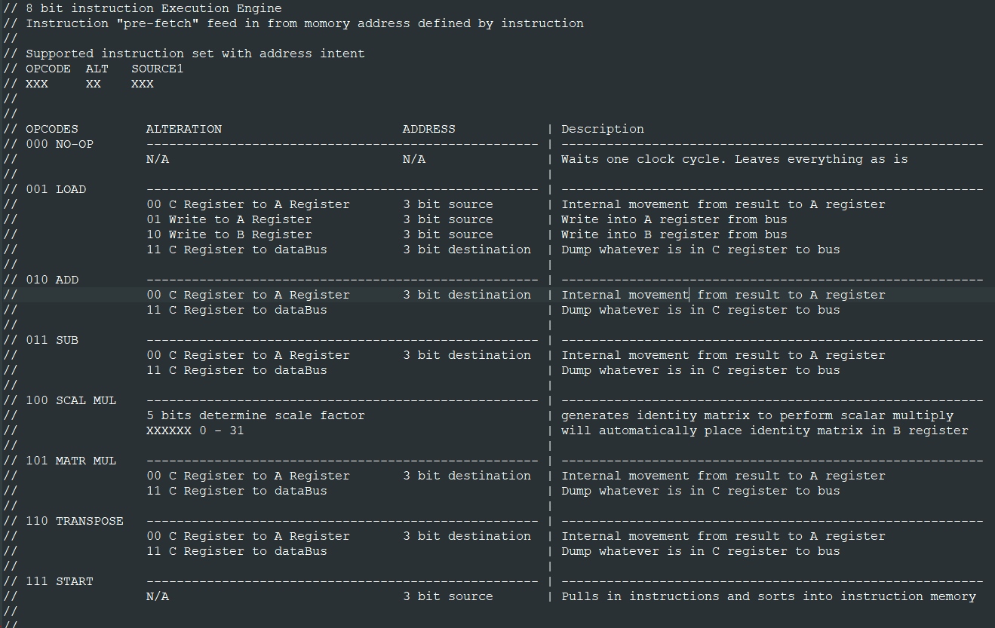

Slide 4
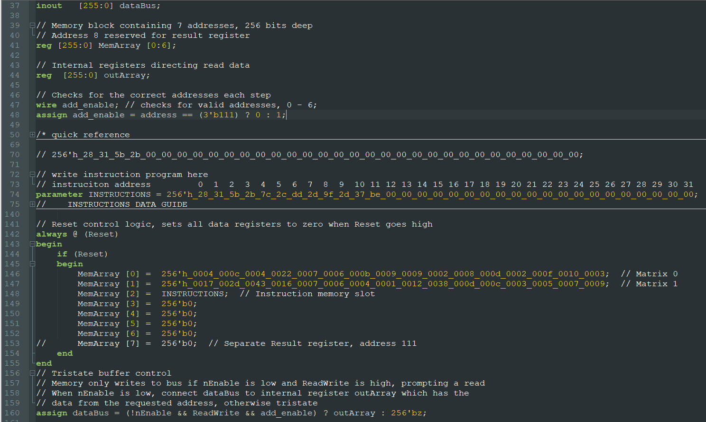
Memory module

Slide 5
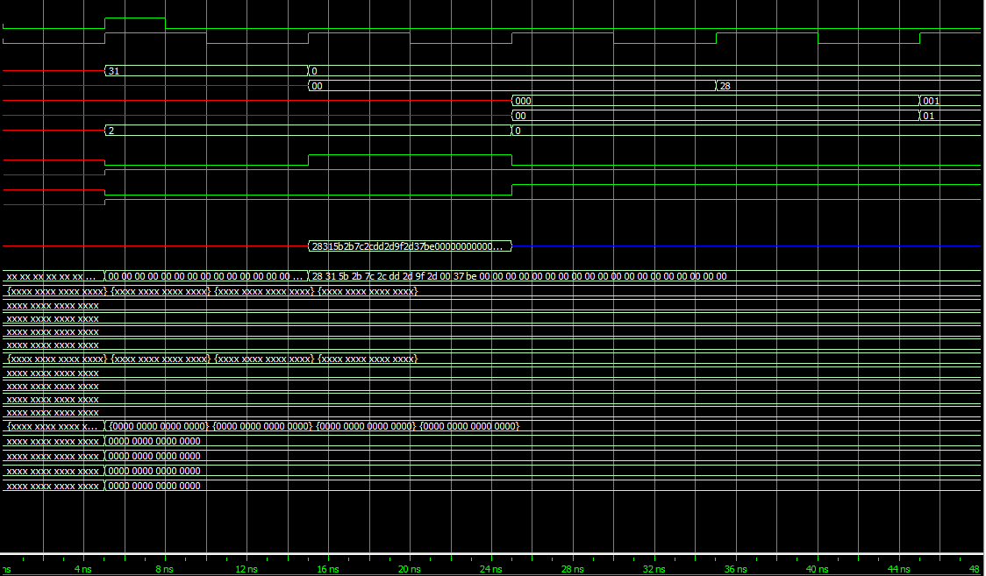
Reset sequence and start of first instruction

Slide 6
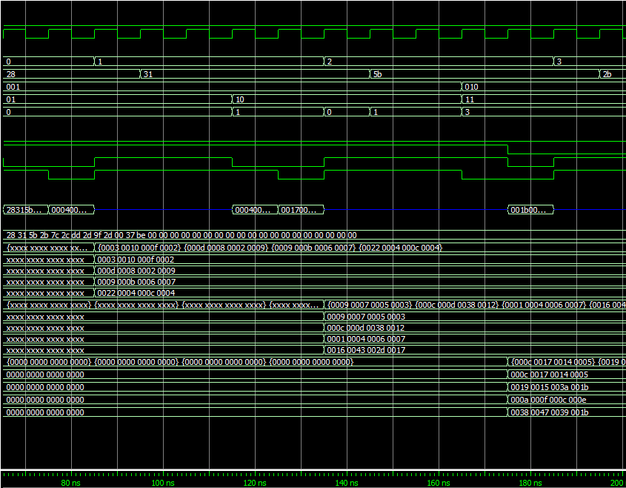
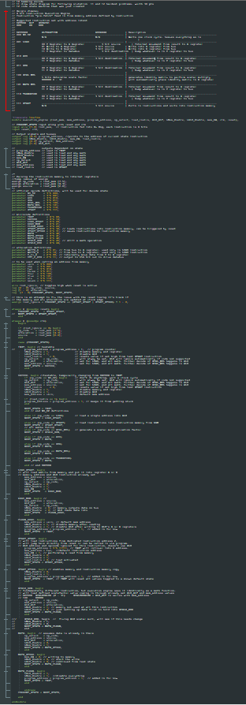

Slide 7
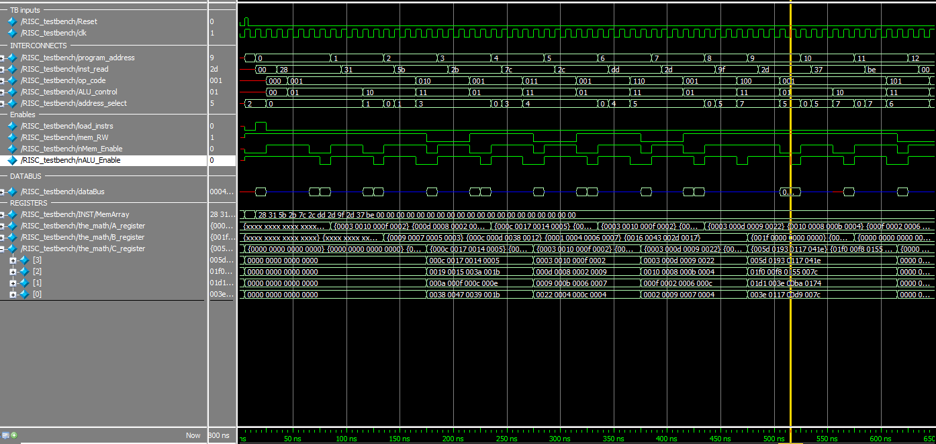

Slide 8
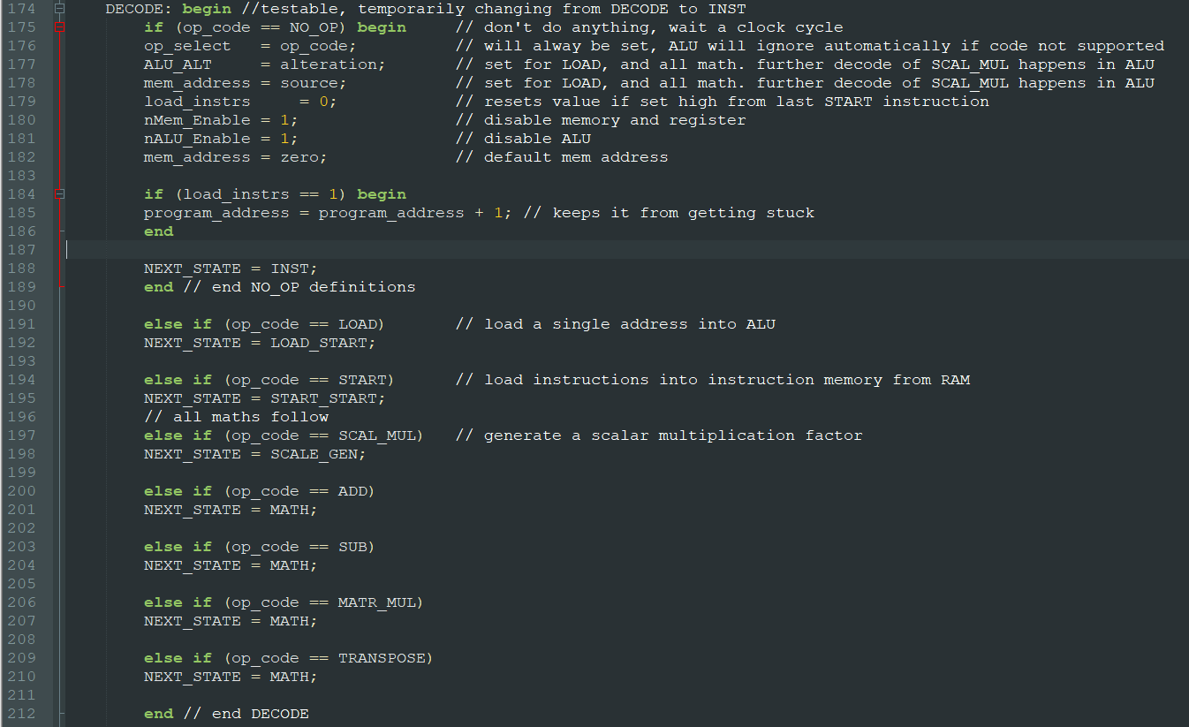

Slide 9
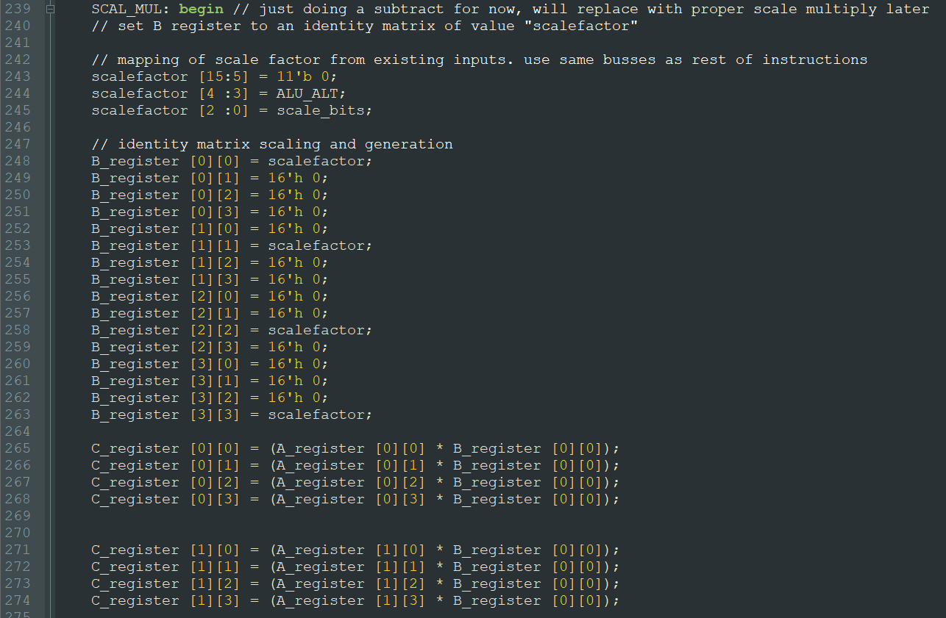
Scale by 8
OPCODE SCALEBITS
100 01000

